Slide 1
Complaint Management System
Group-3
Team
Saransh Bansal Abhay Gupta Aryansh Singla Aayushmaan Jha
Yash Sharma Vastav Bansal
Vishwas Garg

Slide 2
Introduction
Complaint Management
We have developed a portal for registering and managing complaints from the students. This consists of a login and signup portal for authentication.The complaints are then directed to the competent authorities.

Slide 3
Technologies Used
01
04
ExpressJS
Nodemailer
02
05
Mongoose
Bcrypt
03
06
Connect-Flash
Cookie-Parser
Node JS framework that can help us in creating server-side web applications faster and smarter.
Nodemailer is a module for Node. js applications to allow easy as cake email sending.
Object Data Modeling (ODM) library for MongoDB.
All the passwords are hashed using this module only.
All the error or success notifications are done using flash only.
Small data that are stored on a client side and sent to the client along with server requests.

Slide 4
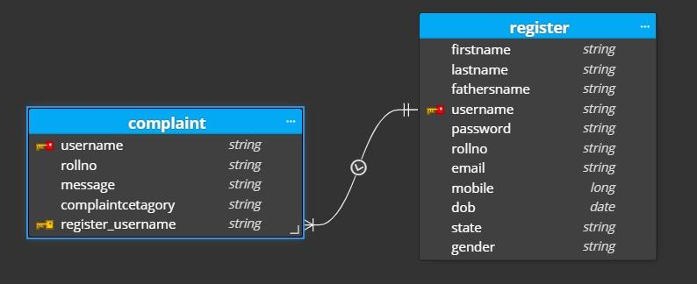
Database Design
Implemented using MongoDB
ER Diagram
ER Diagram

Slide 5
LIVE DEMO

